Slide 1
Synchronous approach
COMMUNICATION WITH

Slide 2
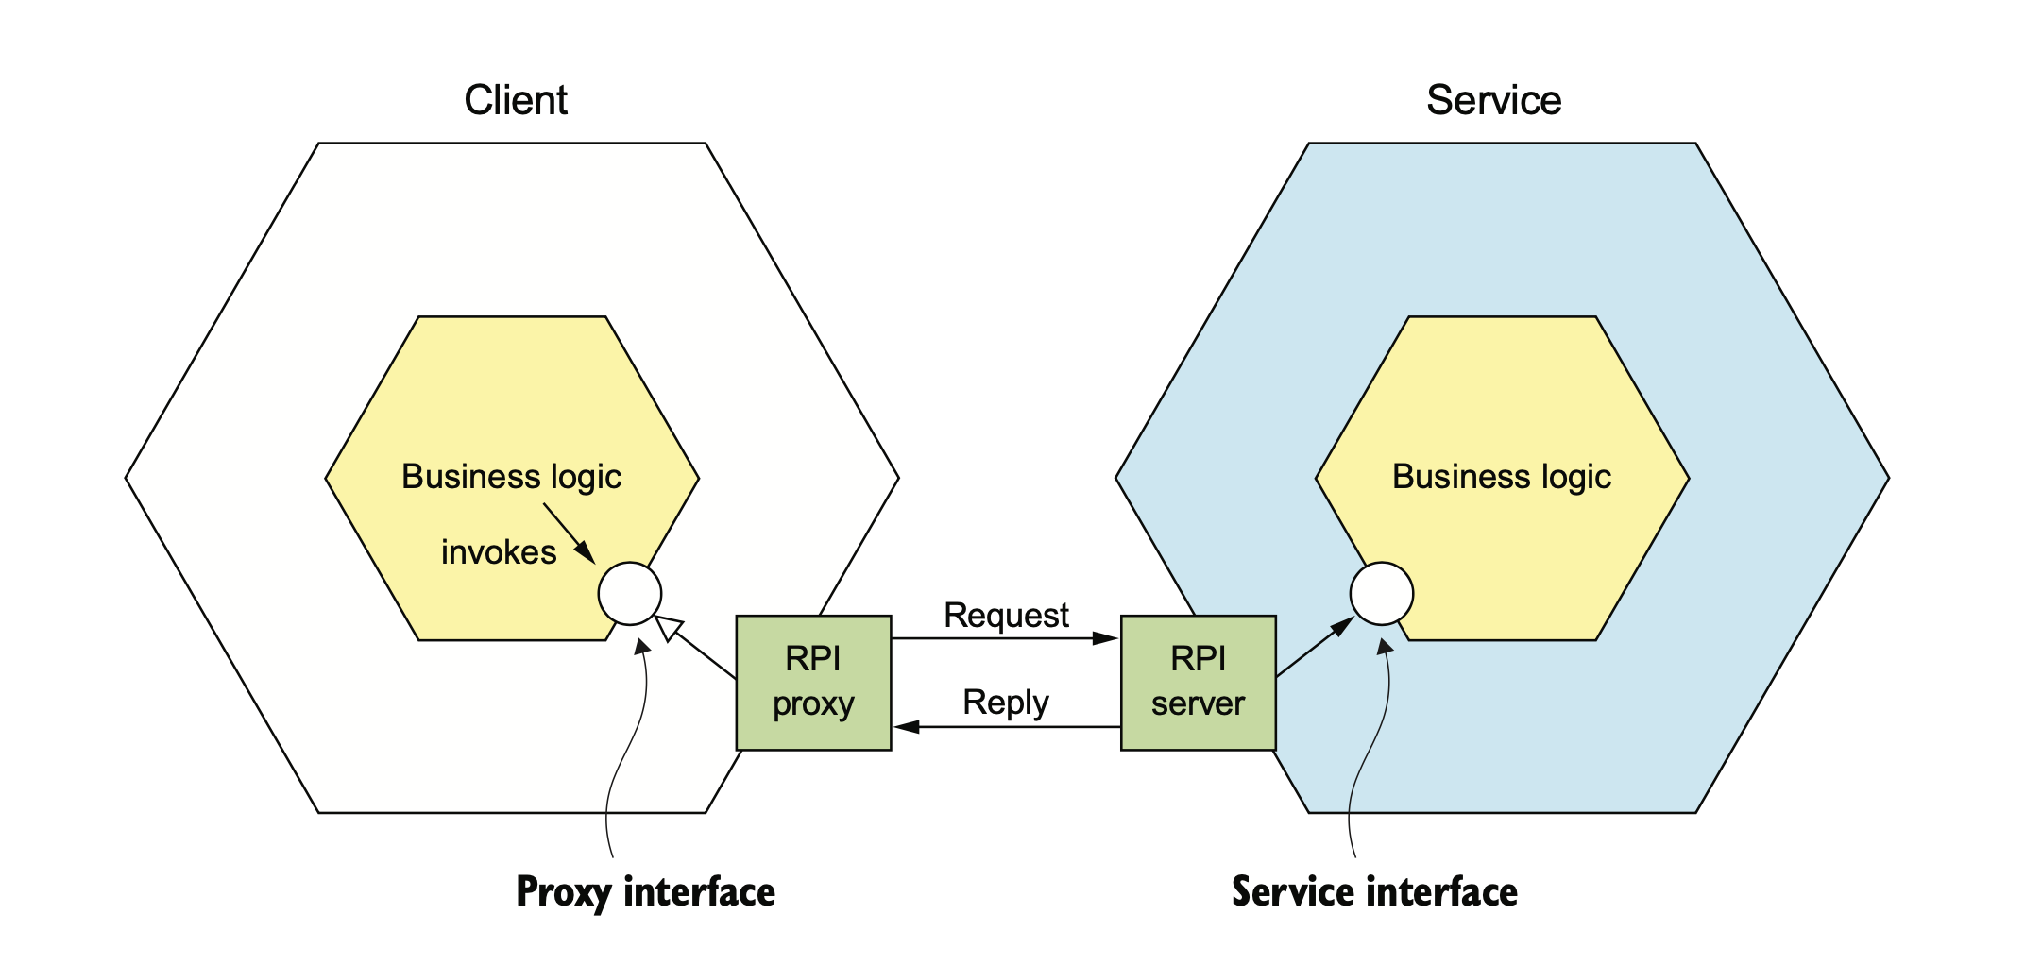

Slide 3
1. Using REST
REST is an IPC mechanism that uses HTTP and the key concept of REST is ’resource’.

Slide 4
What is REST
REST is an IPC mechanism uses HTTP protocol to communicate.
REST uses HTTP verbs such as GET, POST, DELETE, PUT, … for manipulating resources which are referenced using an URL.

Slide 5
What is REST
GET: get details of a resource, ex GET product/1
POST: create a resource, POST product/1
PUT: update a resource, PUT product/1
DELETE: delete a resource, DELETE product/1

Slide 6
Problems in REST
Fetching multiple objects in a single request
Mapping operations to HTTP verbs
I want to retrieve order and order’s consumer
Needs at least two requests
A poor number of HTTP verbs.
How if you want to map your ‘cancel order’ operation to REST?
Using other verbs POST, PUT or DELETE

Slide 7
Benifits & Drawbacks
Benifits
Drawbacks
Simple & Familiar
Test more easily by using browser
Use HTTP
It does not require intermediate broker
Only support request/response
Reduced availability
Clients must know the URL
Fetching multiple resources
Mapping multiples update operations to HTTP verbs

Slide 8
2. Using gRPC
A binary message-based protocol

Slide 9
What is gRPC
gRPC is a binary message-based protocol
You define your gRPC APIs using a Protocol Buffers-based IDL
IDL is a mechanism for serializing structured data.

Slide 10
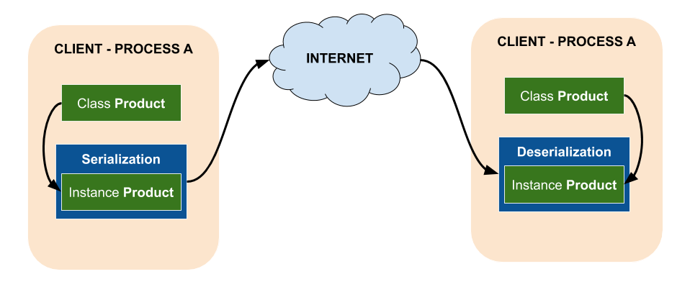
What is gRPC

Slide 11
Benifits & Drawbacks
Benifits
Drawbacks
It does not care HTTP verbs
Compact IPC mechanism
Strong typing
Bidirectional streaming
Older firewall does not support HTTP/2
It takes more work for JavaScript clients to consume gRPC-based API than REST/JSON-based APIs

Slide 12
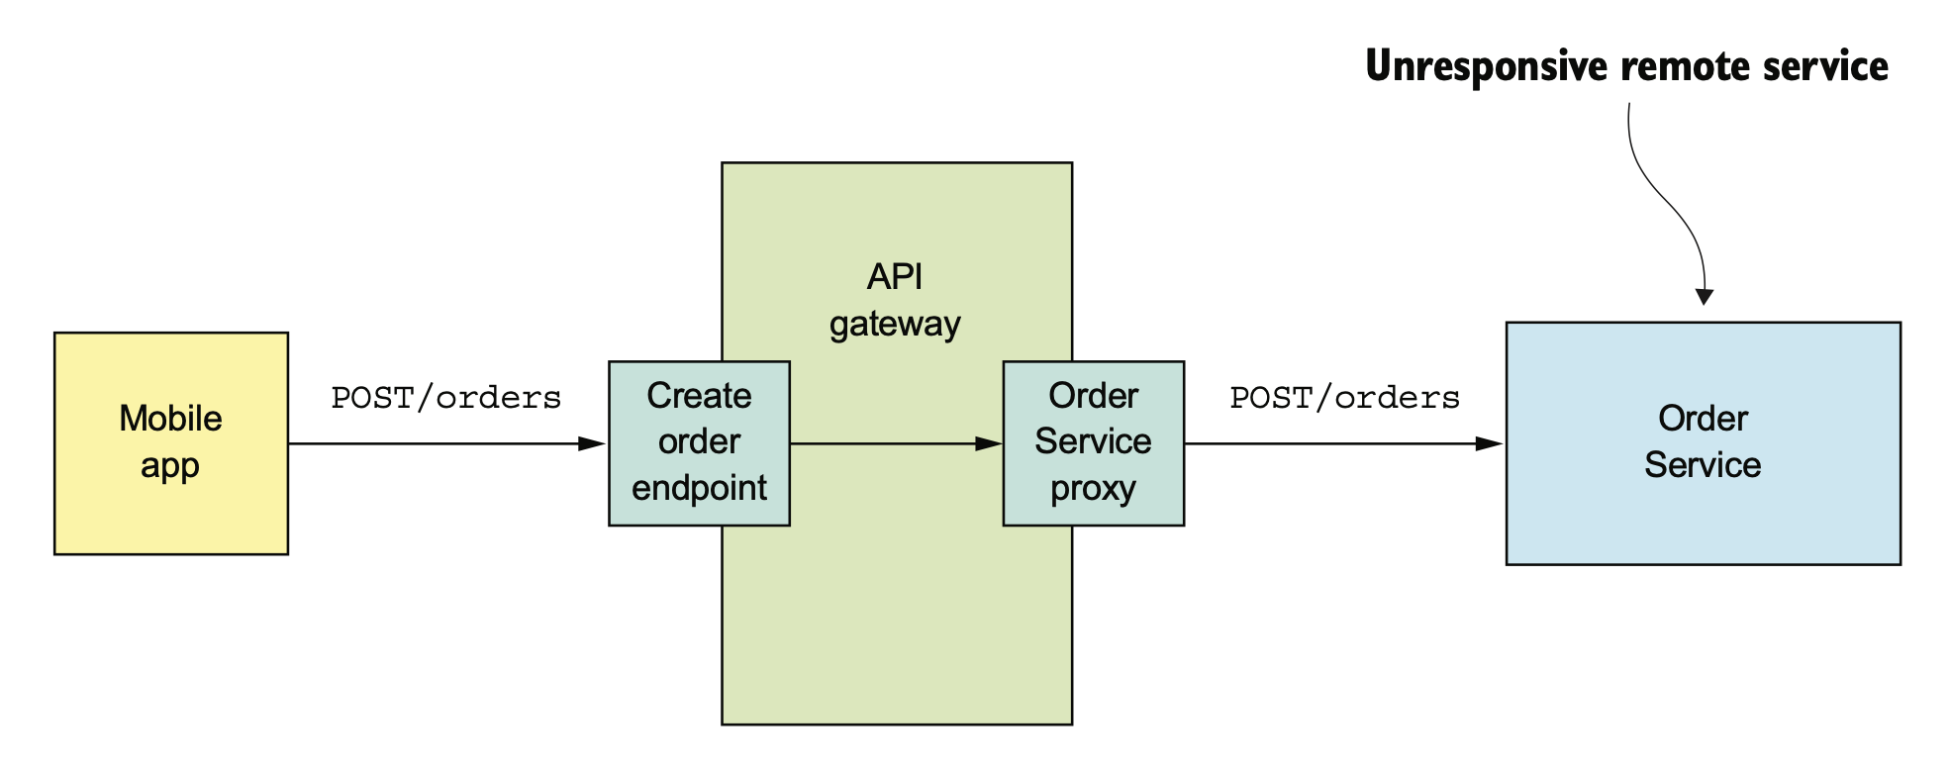
3. Handling partial failure

Slide 13
3. Handling partial failure
Network timeouts
Outstanding requests
VENUS
Never block indefinitely
Always use timeouts when requesting
Impose an upper bound on the number of outstanding requests
If the limit has been reached, those attempts should fail immediately.
Track the number of successful and failed requests.
A big number of requests failing suggests that the service is unavailable

Slide 14
4. Service discovery
You need to know IP in your code to make a request to a service instance.

Slide 15
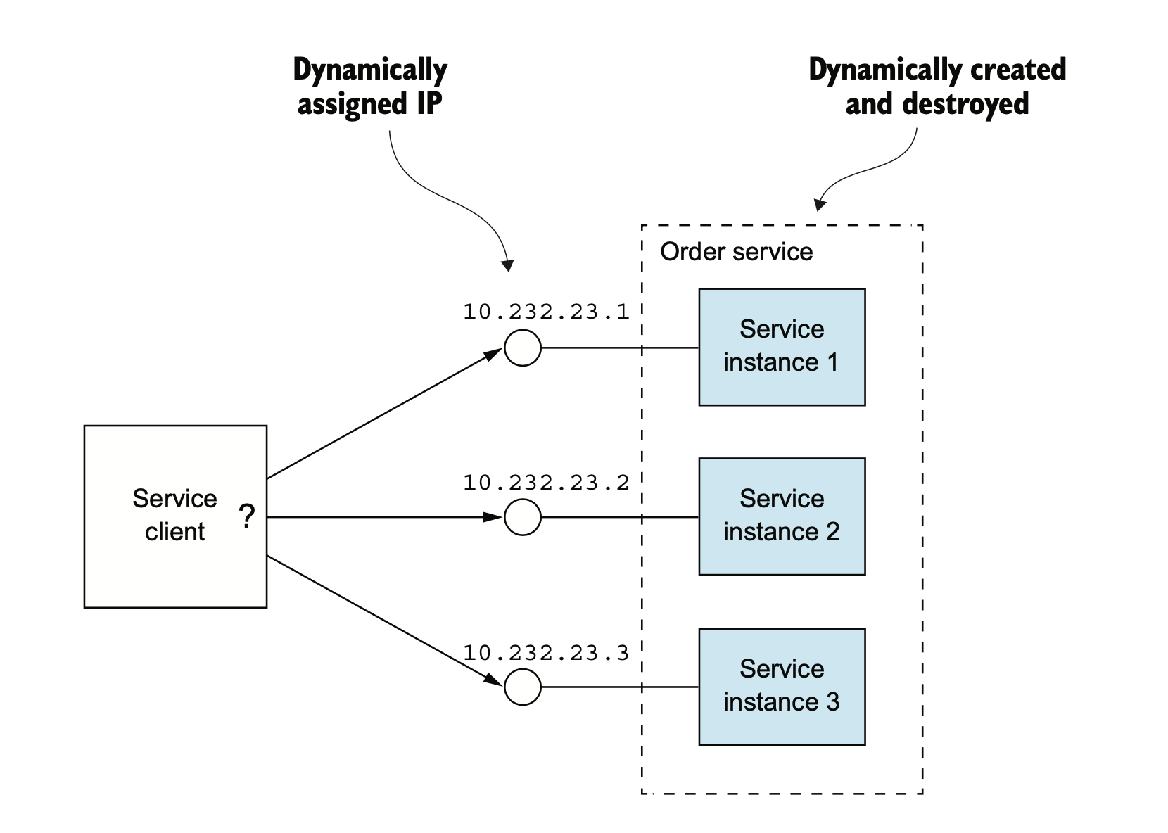
Clients must know all services locations for communicating

Slide 16
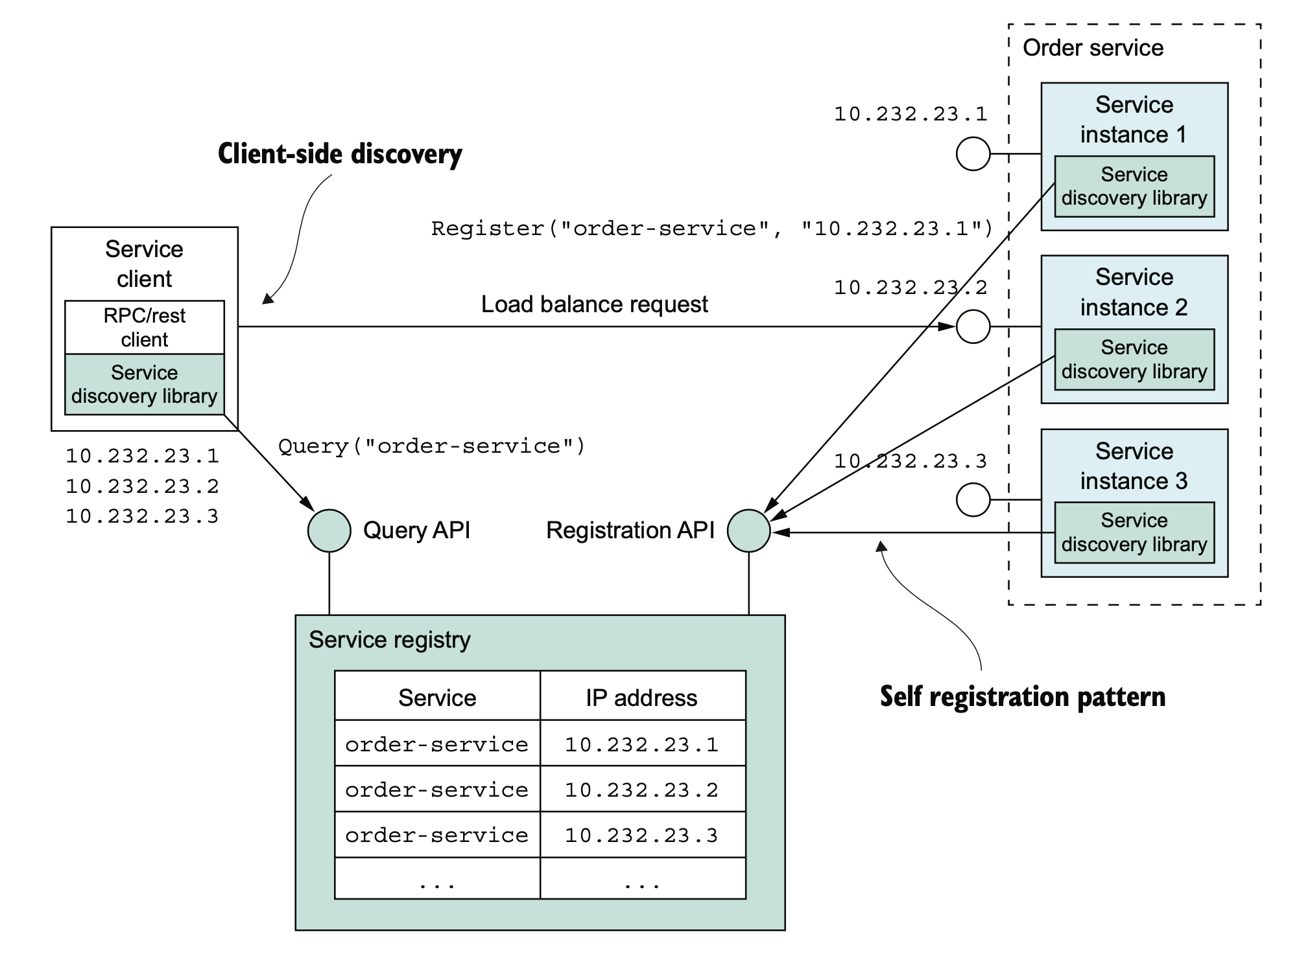
Clients know other services via a service registry

Slide 17
4. Service discovery
SERVICE START
Registering an entry in Service Registry table
SERVICE STOP
Unregistering that entry in Service Registry table
CLIENT GET SERVICE INFO
Client query information from Service Registry table

